Slide 1

DYNAMICAL SYSTEMS
Prof. Dr. Mehmet Önder Efe
E-Mail : onderefe@gmail.com
URL : http://web.cs.hacettepe.edu.tr/~onderefe/
Textbook : M.Ö. Efe, Otomatik Kontrol Sistemleri, Seçkin Y.

Slide 2

Course Outline
PART 1
Introduction to Control Engineering
Review of Complex Variables & Functions Review of Laplace Transform
Review of Linear Algebra
PART 2
Linear Differential Equations
Obtaining Transfer Functions (TFs)
Block Diagrams
An Introduction to Stability for TFs
Concept of Feedback and Closed Loop
Basic Control Actions, P-I-D Effects
2/17

Slide 3

PART 3
Concept of Stability
Stability Analysis of the Closed Loop
System by Routh Criterion
State Space Representation and
Stability
PART 4
Transient Response Analysis
First Order Systems
Second Order Systems
Using MATLAB with Simulink
Steady State Errors

Slide 4

PARTS 5-6
Root Locus Analysis
Design Based on Root Locus
Midterm
PART 7
Frequency Response Analysis
Bode Plots
Gain Margin and Phase Margin
Polar Plots and Margins
Nyquist Stability Criterion

Slide 5
PARTS 8-9
Design of Control Systems in State Space
Canonical Realizations
Controllability and Observability
Linear State Feedback
Pole Placement
Bass-Gura and Ackermann Formulations
Properties of State Feedback
Observer Design and
Observer Based Compensators

Slide 6
PART 10
Concept of Robustness
Concept of Optimality
Concept of Adaptive Systems
Concept of Intelligence in Control
PART 11
Final Exam

Slide 7
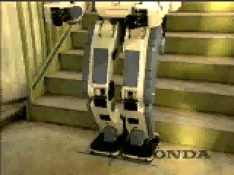
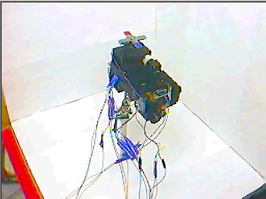
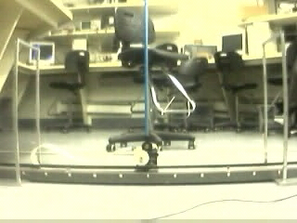
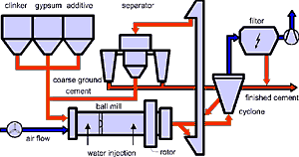
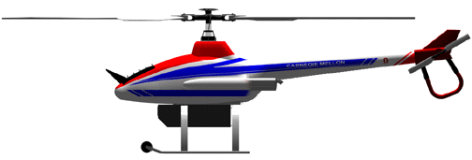

P-1 Introduction to Dynamical Systems
© Honda, Humanoid Robot
Courtesy: Efe, Acay, Unsal,
Vande Weghe, Khosla,
Carnegie Mellon University, 2001
Courtesy: Acay
Carnegie Mellon University, 2001
Industrial process control
Control of unmanned aerial vehicles
Chemical process control

Slide 8
What is a dynamic system?
A dynamical system is a concept in mathematics where a fixed rule describes the time dependence of a point in a geometrical space.
http://en.wikipedia.org/wiki/Dynamical_system

Slide 9
What is control theory?
The mathematical study of how to
manipulate the parameters affecting
the behavior of a system to produce
the desired or optimal outcome.
http://mathworld.wolfram.com/ControlTheory.html

Slide 10
How to classify in terms of time?
• Continuous time systems
-Differential equations
° Laplace transform
• Discrete time systems
-Difference equations
° Issues of sampling
° z Transform

Slide 11
How to classify in terms of representation?
• Linear systems
-Differential equations
-Difference equations
• Nonlinear systems
-Differential equations
-Difference equations

Slide 12
How to classify in terms of representation?
• Ordinary Differential Equations
• Partial Differential Equations

Slide 13
What common alternatives do we have?
• Proportional Integral Derivative
• Classical control
• State space methods
• Optimal control
• Robust control
• Nonlinear control
• Stochastic control
• Adaptive control
• Intelligent control
• ...

Slide 14
What engineering aspects should we consider?
• Disturbance rejection
• Insensitivity to parameter variations
• Stability
• Rise time
• Overshoot
• Settling time
• Steady state error
• ...

Slide 15
What else should we think about?
• Cost (money/time)
• Computational complexity
• Manufacturability (any extraordinary
requirements?)
• Reliability (mean time between failures)
• Adaptability (with low cost for similar
applications)
• Understandability
• Politics (opinions of your boss and
distance from standard practice)

Slide 16
What mathematical tools shall we use?
• Calculus & Linear Algebra
• Laplace Transform
• Fourier Transform
• Complex Variables and Functions
• Ordinary Differential Equations (ODE)
• ...

Slide 17
What sort of systems shall we cover?
This course
Hybrid
Systems
Nonlinear
Systems
Linear Systems
Linear & Nonlinear
Continuous & Discrete
Time invariant or varying
Linear
Continuous time
Time invariant
A natural way to follow is to start with
Linear Time Invariant (LTI) Systems

Slide 18
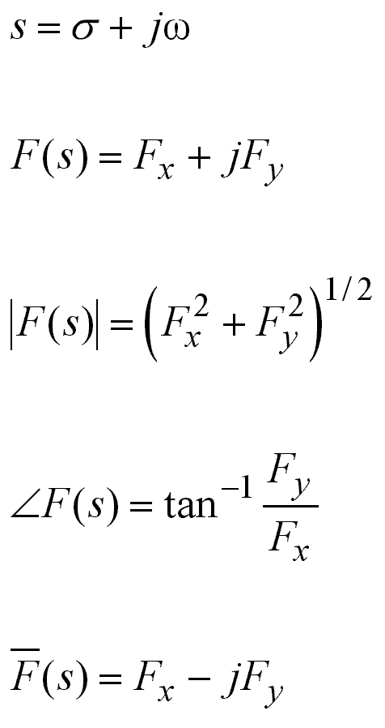
P-1 Review of Complex Variables & Functions
Complex variable
Function of the complex variable s
Magnitude of the function F(s)
Angle of the function F(s)
Complex conjugate of the
function F(s)

Slide 19
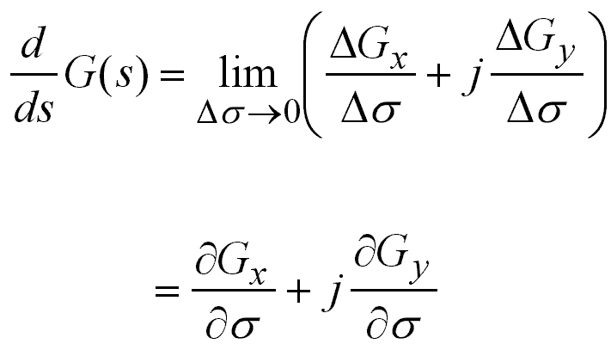
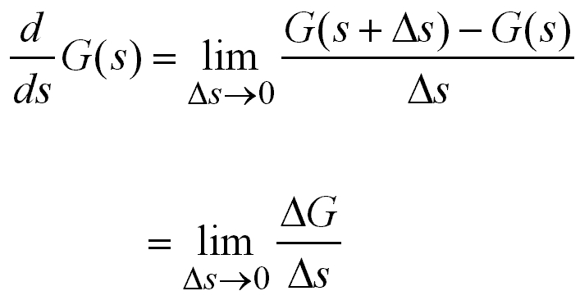
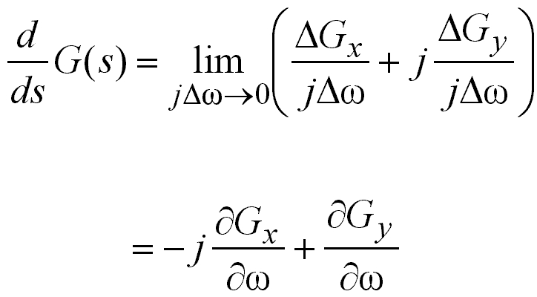

Slide 20
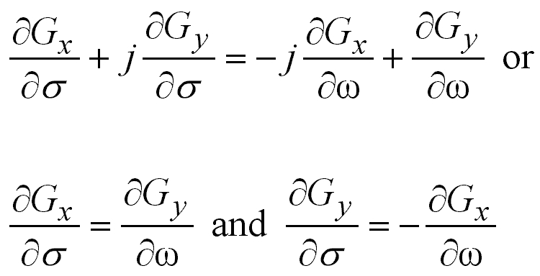
If the derivative along these two directions give
the same value
Cauchy-Riemann
conditions
Then the derivative dG(s)/ds can uniquely be
determined

Slide 21
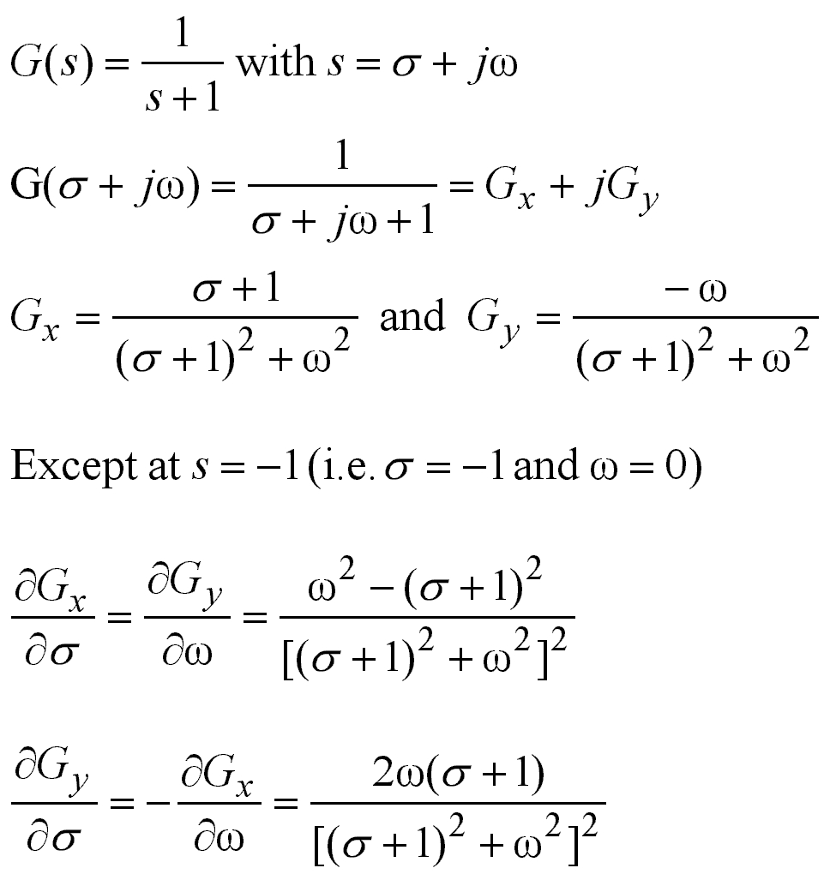

Slide 22
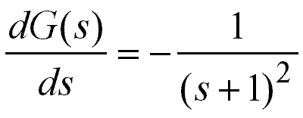
Hence the derivative dG(s)/ds is analytic
in the entire s-plane except at s=-1; the
derivative is as follows:
The derivative of an analytic function can
be obtained by differentiating G(s) simply
with respect to (w.r.t) s.

Slide 23
The points at which the function G(s) is analytic
are called ordinary points
•
•
The points at which the function G(s) is not analytic
are called singular points
•
At singular points the function G(s) or its derivatives
approach infinity, and these points are called poles
•
The function G(s)=1/(s+1) has a pole at s=-1, and
this pole is single. G(s)=1/(s+1)^{p} has p poles all at
s=-1.
•
The function G(s)=(s+3)/[(s+1)(s+2)] has two zeros
at s=-3 and s=∞; and two poles at s₁=-1 and s₂=-2

Slide 24
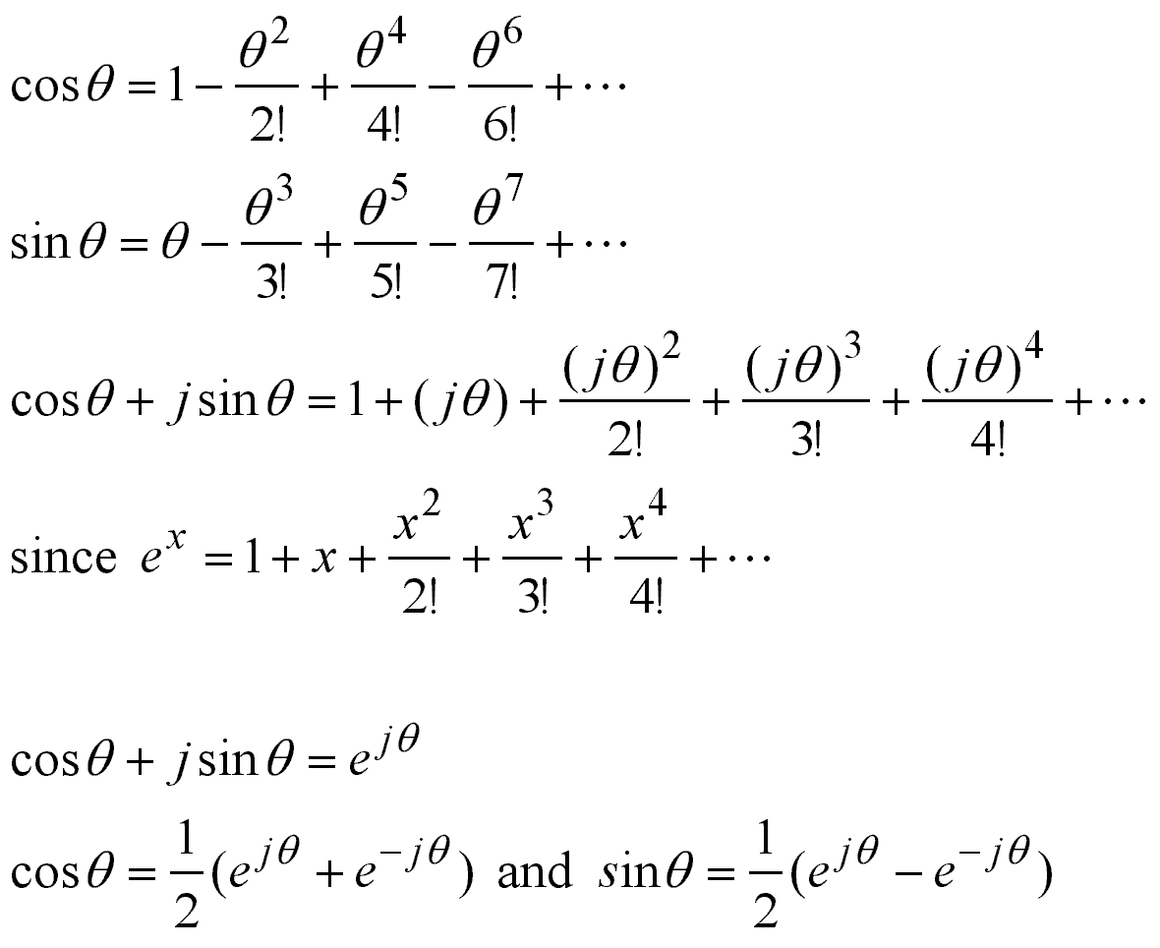
Euler’s Theorem
j

Slide 25
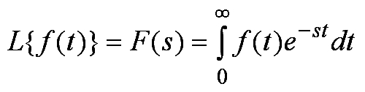
P-1 Review of Laplace Transform
f (t) A function of time such that f (t)=0 for t<0
s A complex variable
L Laplace operator
F(s) Laplace transform of f (t)
The Laplace transform is given by

Slide 26
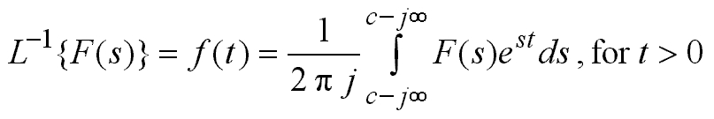
The inverse Laplace transform is given by
+
Where c, the abscissa of convergence, is a real
constant and is chosen larger than the real parts
of all singular points of F(s). Thus, the path of
integration is parallel to the jω axis and is displaced
by the amount c from it. This path of integration
is to the right of all singular points.
We will utilize simpler methods for inversion

Slide 27
When does the Laplace transform exist?
The Laplace transform exists if the Laplace integral
converges, more explicitly
IF f (t) is sectionally continuous on every finite
interval on the range t > 0
AND
IF f (t) is of exponential order as t→∞

Slide 28
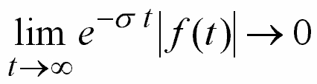
Which functions are of exponential order?
A function f (t) is said to be of exponential order
if a real positive σ exists such that
If this limit approaches zero for σ>σ_{c}, then σ_{c} is
said to be the abscissa of convergence

Slide 29
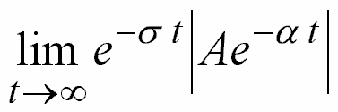
For example
This is f (t)
•
This limit approaches zero for σ>−α.
The abscissa of convergence is therefore σ_{c}=−α
The Laplace integral will converge only if s, the
real part of s, is greater than the abscissa of
convergence
•
•
The Laplace integral

Slide 30
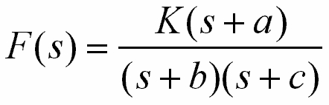
What is the abscissa of convergence of
Hint: Find partial fractions, and take inverse
Laplace transform, find f (t), and check if
The answer is σ_{c} > max(−b, −c). This will be clear
after we see how to perform the inversion.

Slide 31
The first conclusion by
Analytic Extension Theorem
If L{f (t)}=F(s) is obtained, and σ_{c} is determined,
F(s) is valid on the entire s-plane except at the
poles of F(s).
The second conclusion by
Physical Realizability
Functions like f (t)=e^{t2} or f (t)=te^{t2}, which increase faster than the exponential function, do not have
Laplace transform, however, on finite time intervals they do.

Slide 32
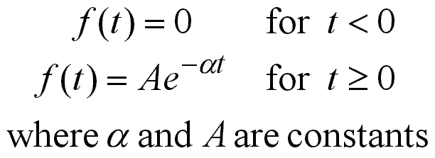
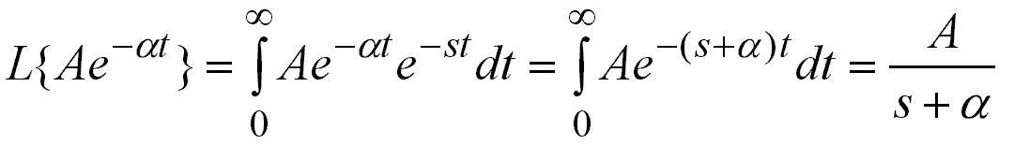
Laplace transform of
Exponential Function
The abscissa of convergence: s > −α
Exponential function produces a pole in the complex plane

Slide 33
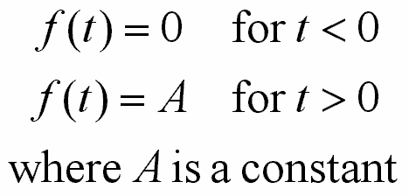
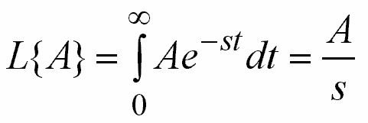
Laplace transform of
Step Function, 1(t)
The abscissa of convergence: s > 0
Step function produces a pole at the origin of the complex plane

Slide 34
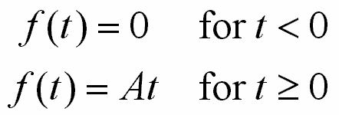
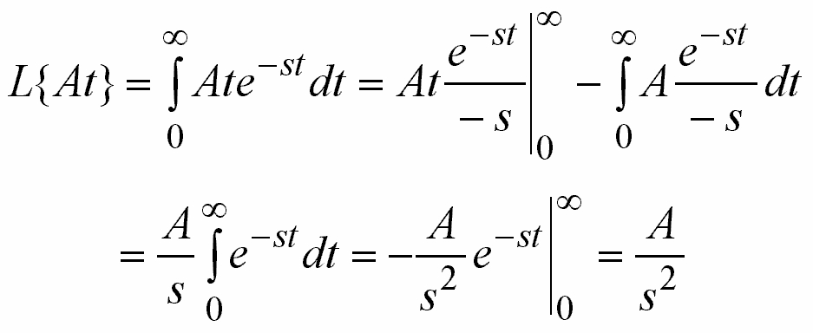
Laplace transform of
Ramp Function
Ramp function produces double poles at the origin of the complex plane

Slide 35
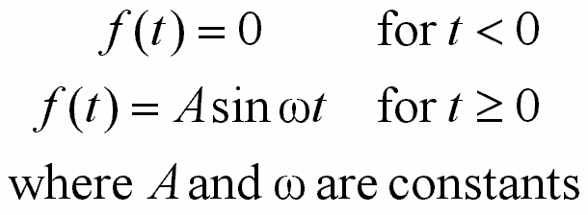
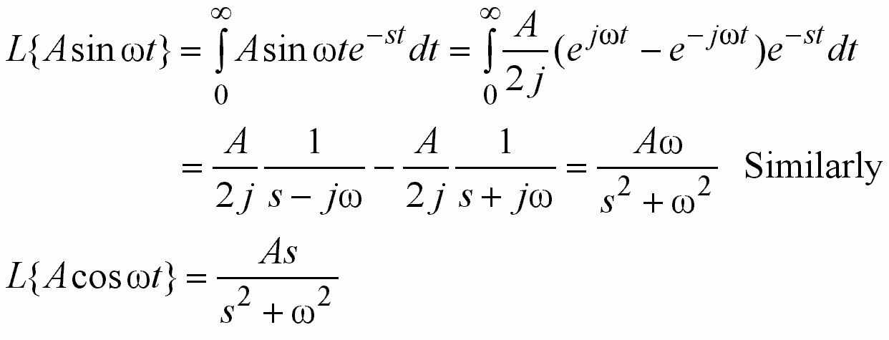
Laplace transform of
Sinusoidal Function
Sinusoidal functions produce poles on
the imaginary ( jω ) axis

Slide 36
Several Properties of Laplace Transform
&
Laplace Transforms of Important Functions

Slide 37
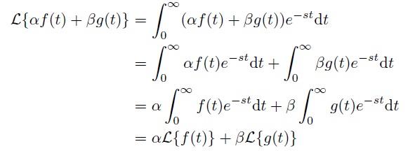
1. Linearity

Slide 38


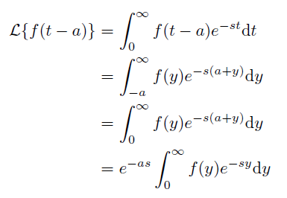
2. Time Shift (Delay, Advance)

Slide 39

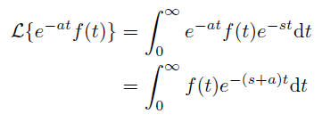
3. Multiplication by e^{−at}

Slide 40

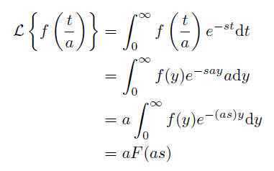
4. Change of Time Scale a > 0

Slide 41
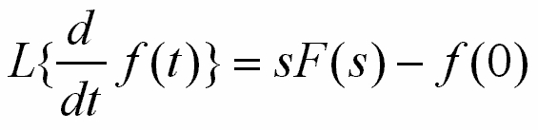
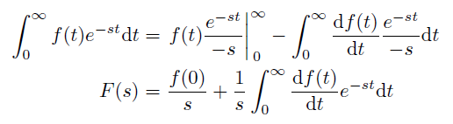

5. Real Differentiation

Slide 42
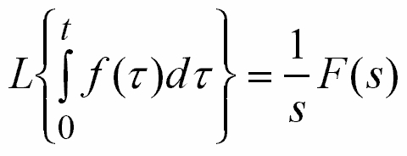

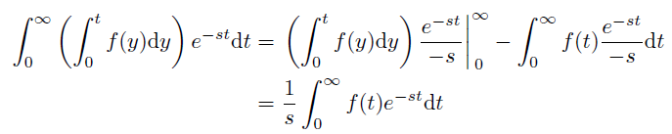

6. Real Integration
If f (t) is of exp. order
Apply integration by parts

Slide 43
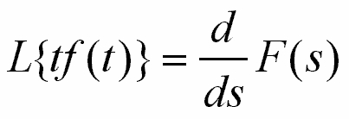

7. Multiplication by t

Slide 44
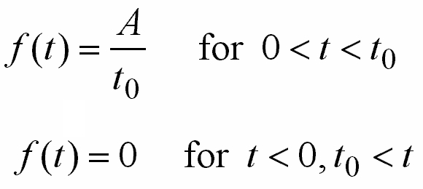
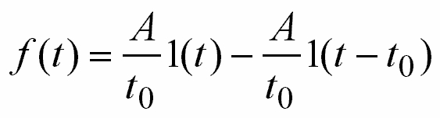
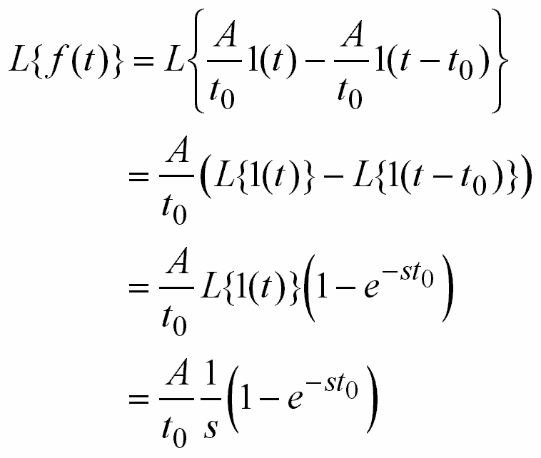
8. Laplace Transform of a Pulse
f (t)
A/t₀
0
t₀

Slide 45
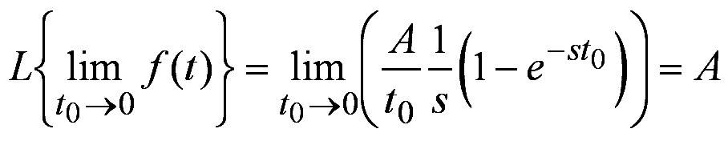
9. Laplace Transform of Impulse Function
f (t)
A/t₀
0
t₀

Slide 46

10. Final Value Theorem
This theorem can be applicable if
f (t) settles down to a constant limit
sF(s) has no poles on the imaginary axis, this
obviously means oscillations in f (t)
sF(s) has no poles on the right half s-plane
•
•
•

Slide 47
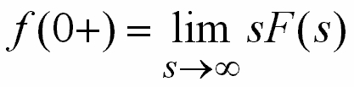
11. Initial Value Theorem
This Theorem can be applicable if
f (t) and df (t)/dt are both Laplace transformable
The limit on the right hand side exists
•
•

Slide 48

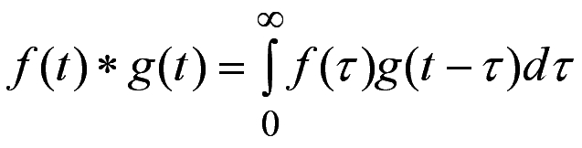

12. Laplace Transform of Convolution
where
t
and by duality

Slide 49
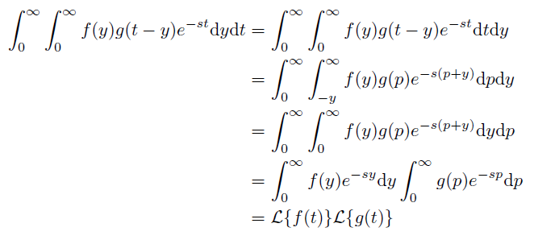

Slide 50
Inverse Laplace Transform

Slide 51
Typical Inversion Methods
•
Use of inversion integral
Complicated and generally takes long time
•
Use of table (Textbook pp.22-23)
Easiest way but you may not always be able
to find what you are looking for in the table
explicitly
We will take a look at Partial Fraction Expansion

Slide 52
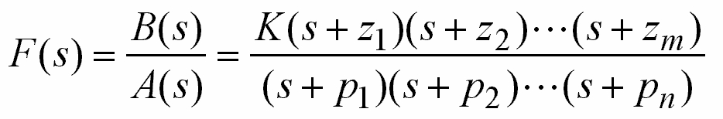
Partial Fraction Expansion
Consider
where m<n.
If m=n, then find out the constant term and separately write in the expansion, then invert.
If m>n, then find out the polynomial in s, and write and invert it separately.
−z_{i}’s are zeros and −p_{i}’s are poles.
Poles and zeros may be complex numbers as well
•
•
•
•

Slide 53
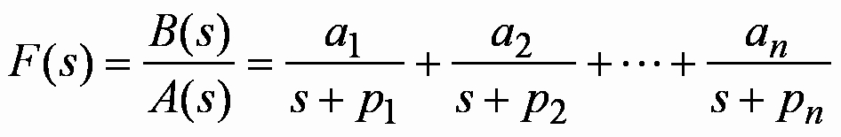
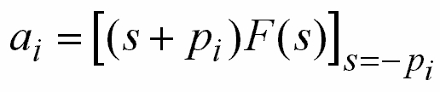
If m<n, the expression
can be expanded as
where

Slide 54
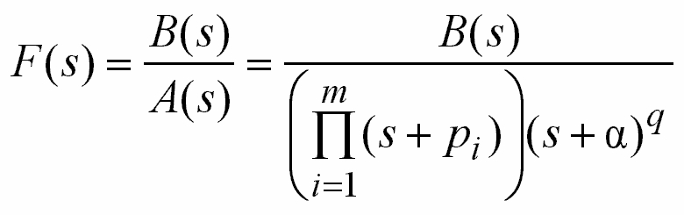
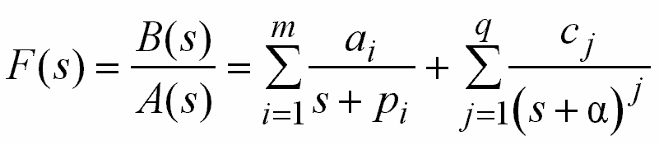
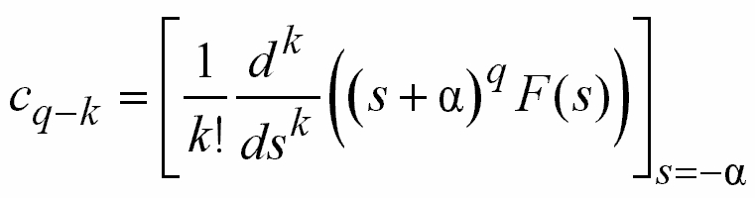
Consider
where, deg A<q+m. This expression can be expanded as
with
k=0,1,…,q−1

Slide 55

Example (2.3 from book)
Find the inverse Laplace transform of

Slide 56
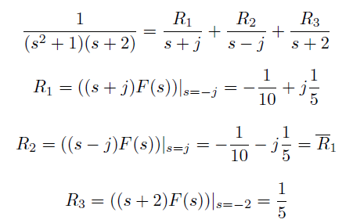
Example (2.4 from book)
Find the inverse Laplace transform of

Slide 57





Slide 58
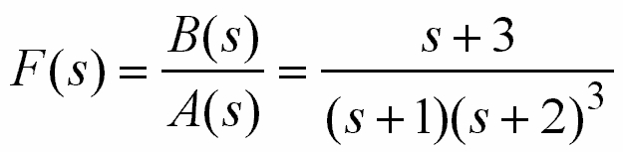

An Example
Find the inverse Laplace transform of
Solution: Rewrite it as

Slide 59





Slide 60





Slide 61

Example (2.5 from book)
Find the inverse Laplace transform of

Slide 62


Slide 63







Slide 64

Example

Slide 65

Example 1/5

Slide 66

Example 2/5

Slide 67

Example 3/5

Slide 68

Example 4/5

Slide 69

Example 5/5

Slide 70


Slide 71


Slide 72


Slide 73

P-1 Review of Linear Algebra
Inner (Dot) Product of Vectors

Slide 74



Multiplication of Two Matrices

Slide 75


Determinant

Slide 76

Determinant
Given a determinant, summing two rows and writing the result as one of those rows do not change the value of the determinant.
Similarly, summing two columns and using the result as one of those columns do not change the value of the determinant.

Slide 77



Eigenvalues and Eigenvectors

Slide 78


Characteristic Polynomial
Note that a polynomial is said to be monic if the
coefficient of the highest order term is equal to unity
Cayley-Hamilton Theorem
Every square matrix satisfies its characteristic
polynomial

Slide 79

Kernel and Image
R^{n}
A
R^{m}
Ker(A)
0

Slide 80
Kernel and Image
R^{n}
A
R^{m}
Im(A)

Slide 81


Linear Dependence/Independence
Let
Set
If a set of α_{j} (other than all zero) yields x=0,
then {x₁, x₂,…, x_{k}} set is said to be linearly dependent
otherwise x_{1…k} are linearly independent

